Slide 1
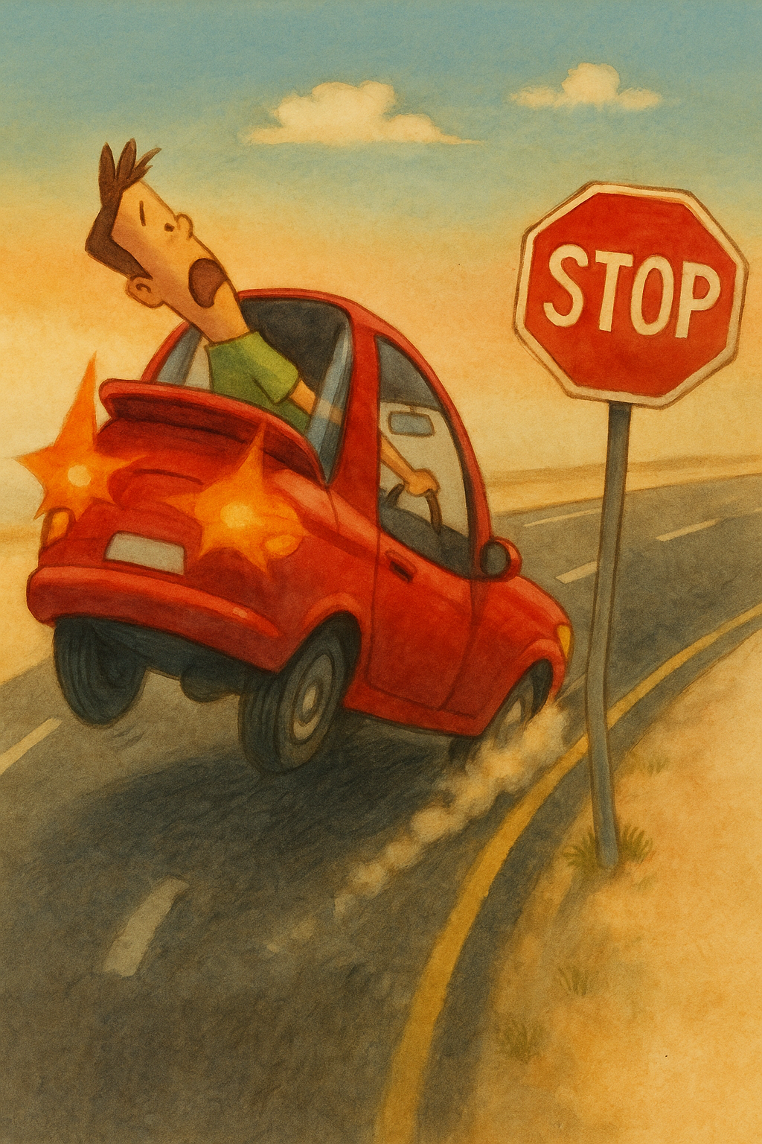
Stop Sign Detection
Group: 08
Abdul Alim Rakib
Sumaya Shimu Rima
Shakib Ahamed
Md Naimur Rahman

Slide 2
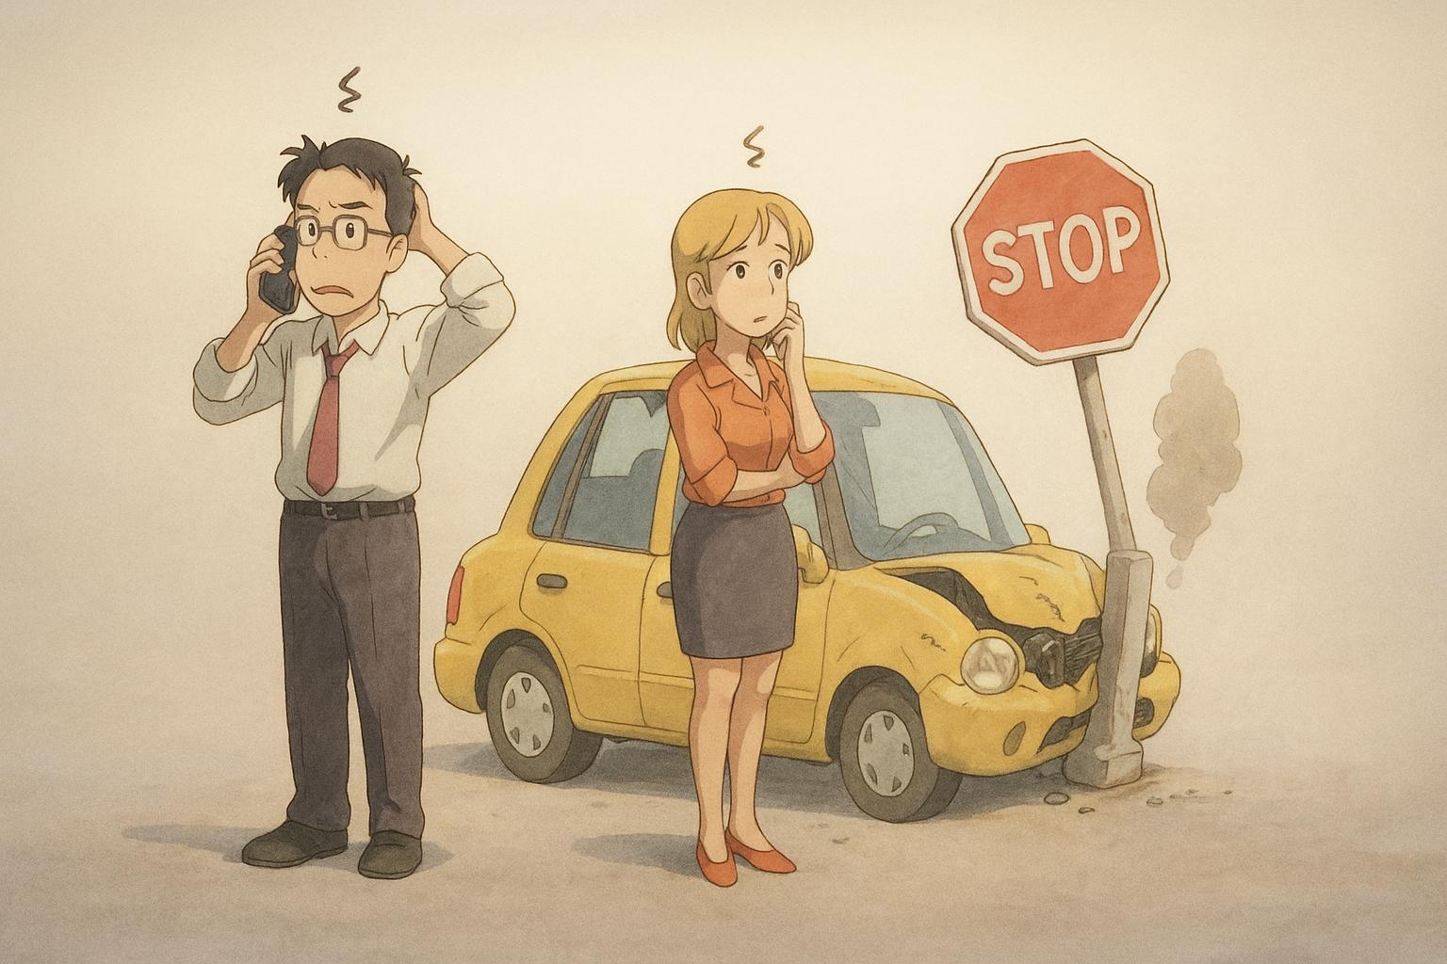
Introduction
Goal
Detect stop signs with machine learning
Why
Enhance autonomous driving, smart traffic
Methods
Multiple Methods, KNN, MLP, CNN
Progress
Model trained with augmented datasets
Aim
Demonstrate effectiveness in traffic recognition

Slide 3



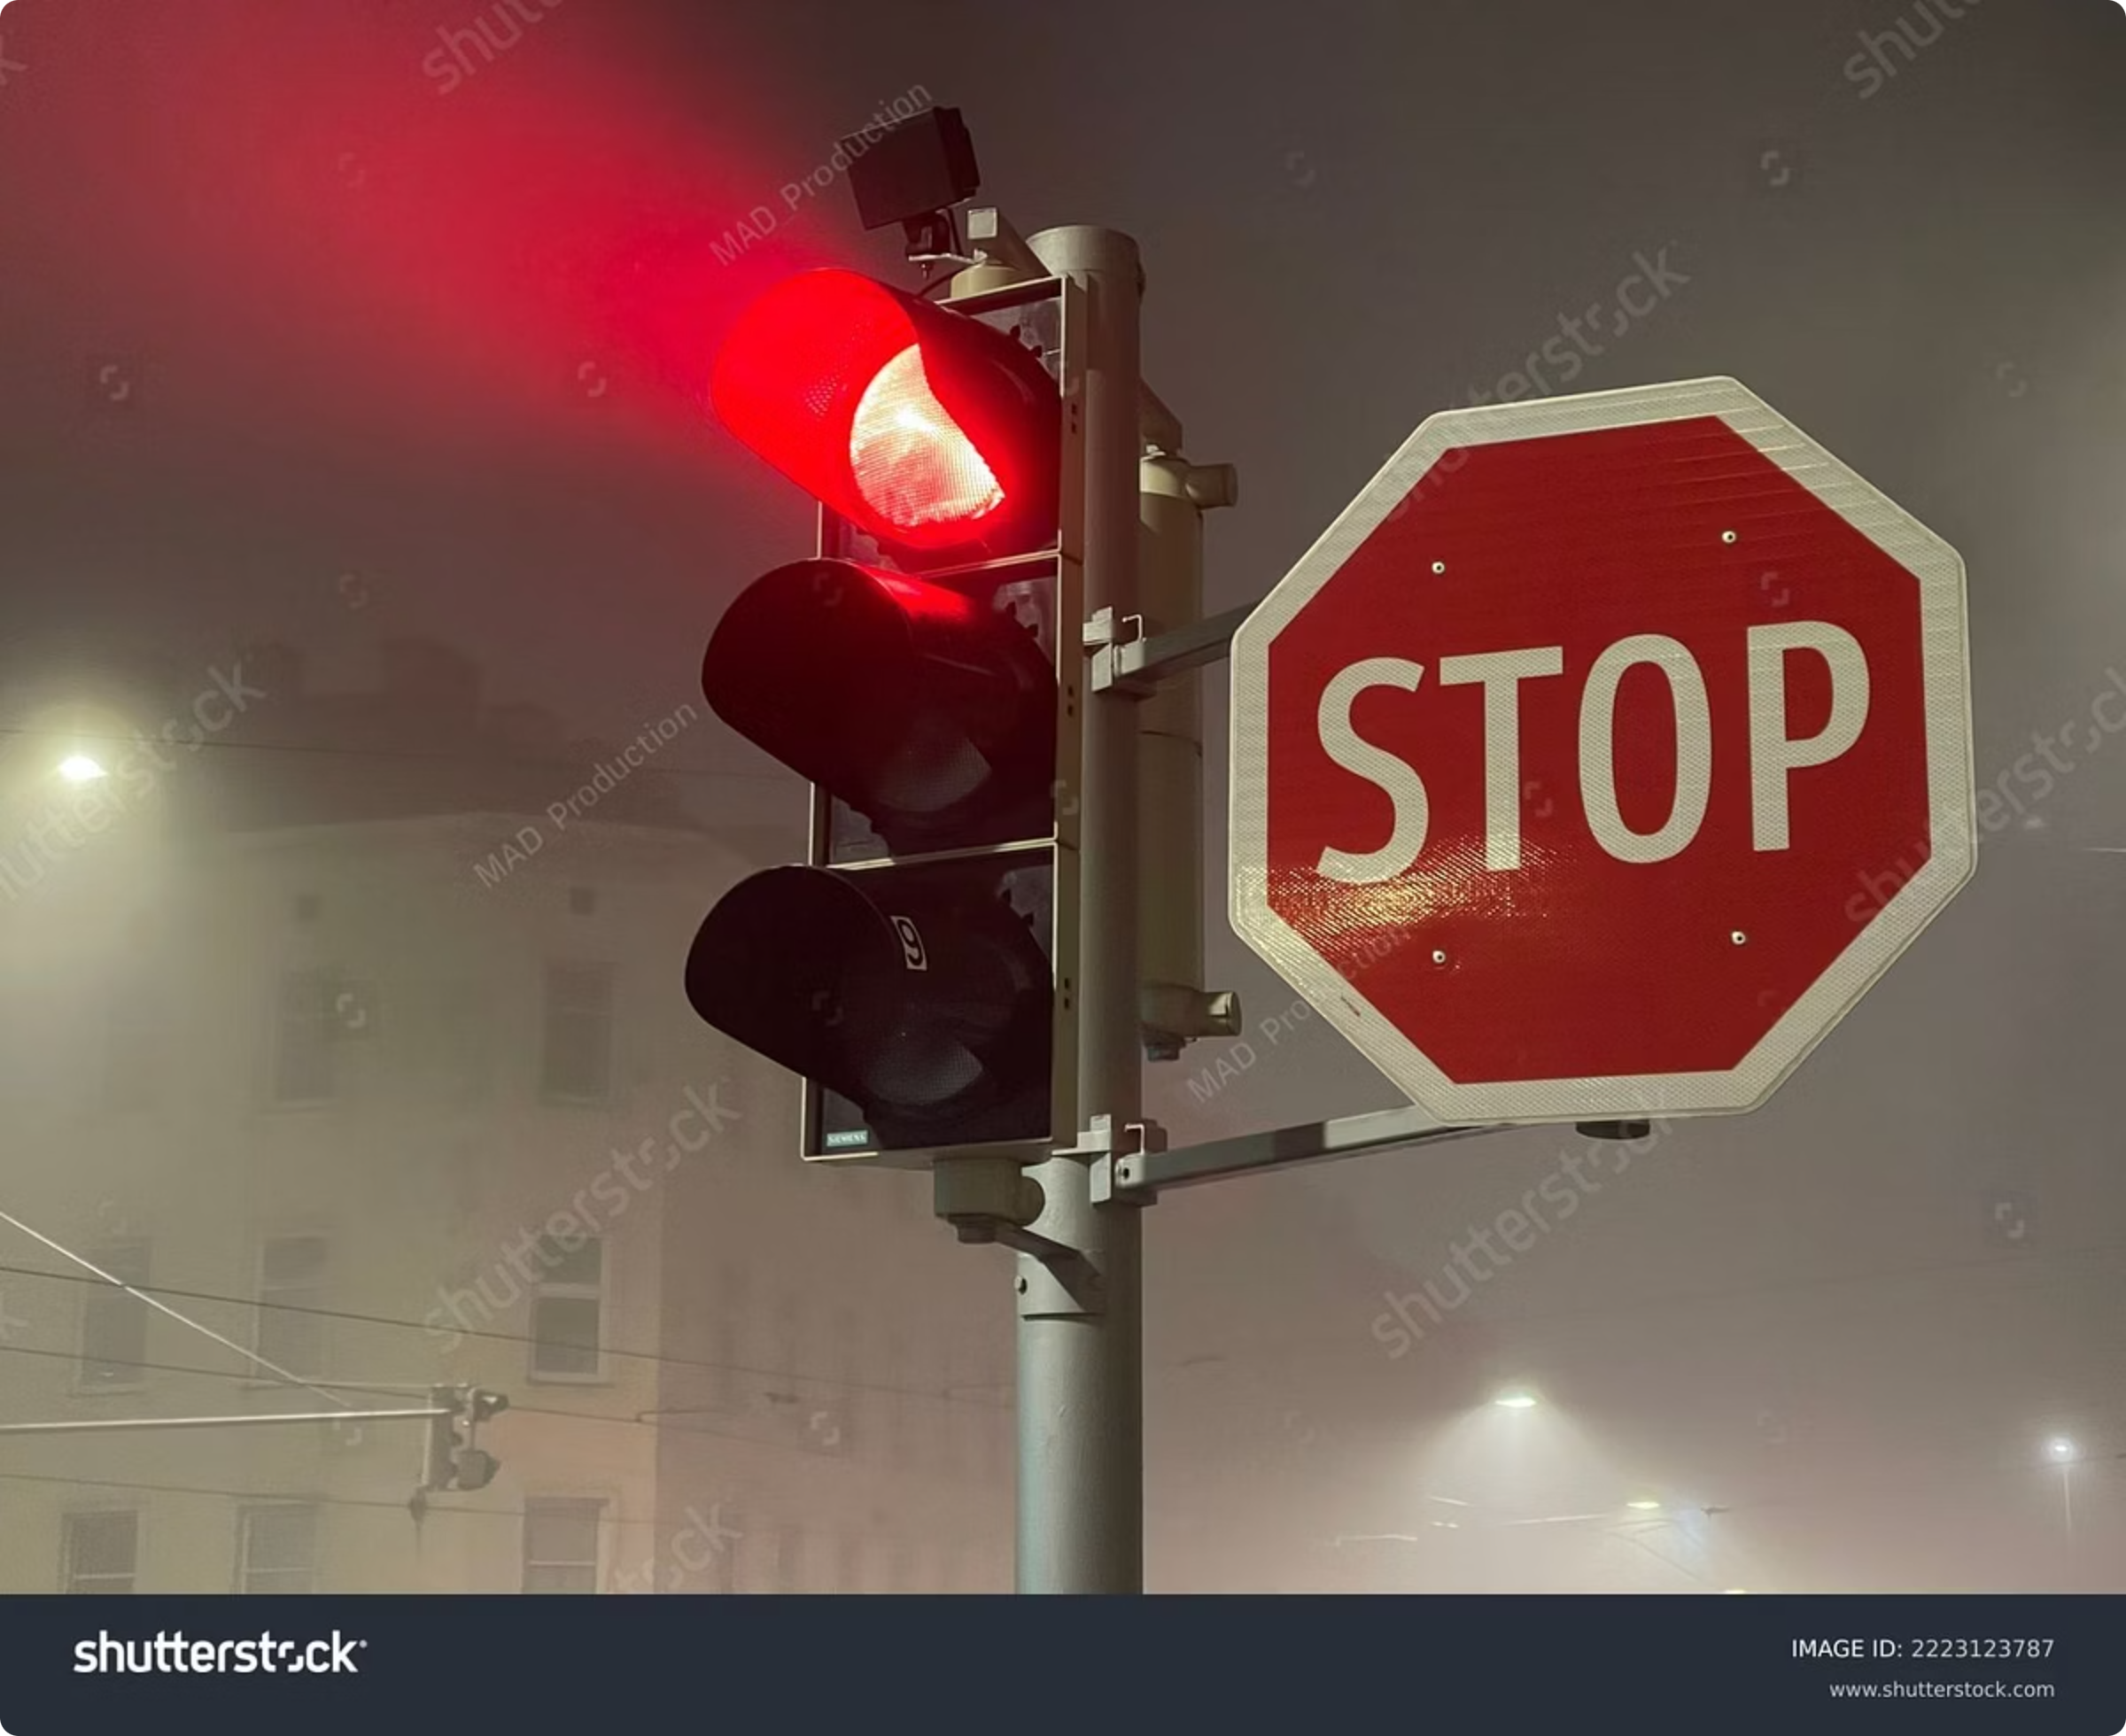

Features
ML MODEL IMPLEMENTATION
Real-time Recognition
Stop sign detection with machine learning.
Real-time object recognition from images
Data Augmentation
Data Extraction
Preprocessing for improved model performance.
Model training, validation, and performance assessment.
Deployment for real-world use cases.

Slide 4

Language
Python
Methods
KNN, MLP, CNN, etc
GROUP:08: Md. Naimur Rahman, Abdul Alim Rakib, Sumaya Shimu Rima Shakib Ahamed

Slide 5
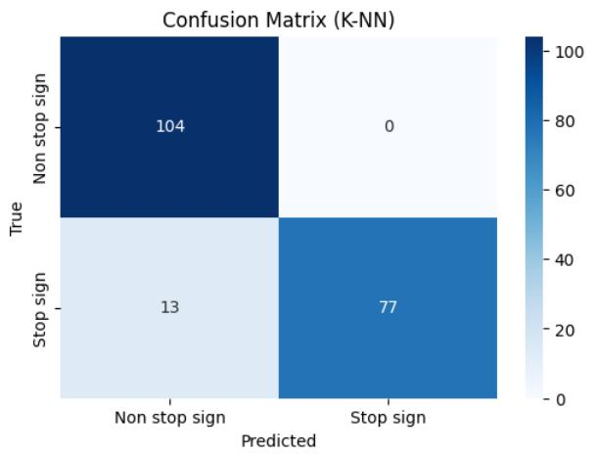
Results & Evaluation
Precision: Accuracy of positive detections
Recall: Ability to find all positive samples
F1-score: Harmonic mean of precision and recall
GROUP:08: Md. Naimur Rahman, Abdul Alim Rakib, Sumaya Shimu Rima, Shakib Ahamed

Slide 6




Future Enhancements
Model Performance
Advanced datasets, testing on unseen data
Model Selection
Add CNN, MLP, SVM - Most suitable model for real-world deployment
Optimize Speed
Optimized processing speed for real-time detection

Slide 7


Conclusion
• Built stop sign detection with traditional ML
• Initial results show effectiveness
• Plan: Test more models, improve accuracy
GROUP:08: Md. Naimur Rahman, Abdul Alim Rakib, Sumaya Shimu Rima, Shakib Ahamed

